Slide 1

Tips to build the Forecasting

Slide 2
Objectives
Understand methods for Forecasting
Implement Statistical Forecasting methods
Tips to build the Forecasting

Slide 3
Moving Average Methods
The moving average method is a simple and widely used technique in time series forecasting.
It's particularly useful for smoothing out short-term fluctuations and highlighting longer-term trends or cycles in the data.
The basic idea behind the moving average method is to calculate the average of a set of consecutive data points within a moving window and use this average as a forecast for future values.
Tips to build the Forecasting

Slide 4
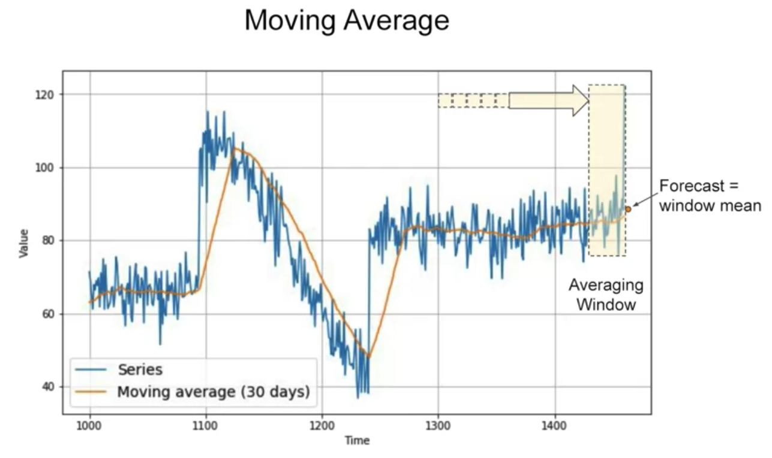
Moving Average Methods
Tips to build the Forecasting

Slide 5
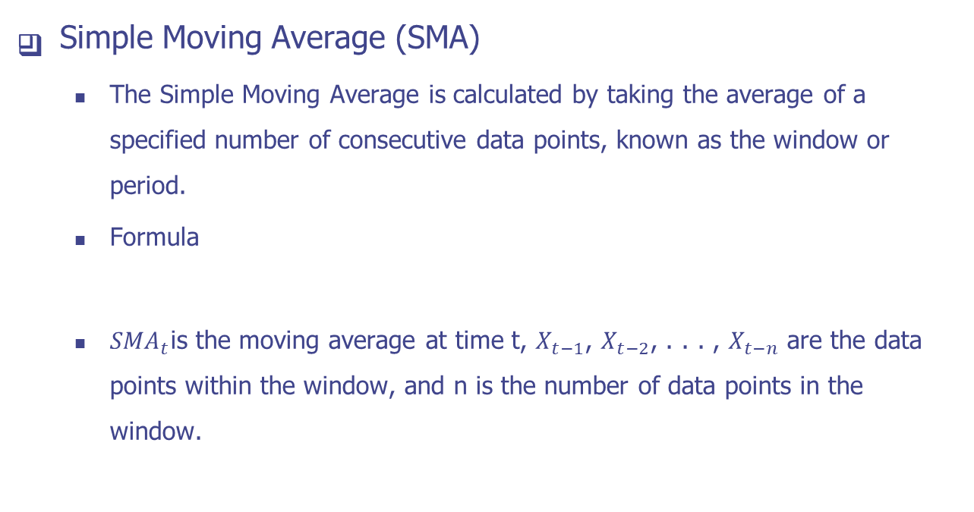
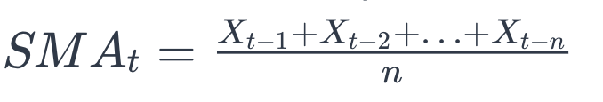
Moving Average Methods
Tips to build the Forecasting

Slide 6
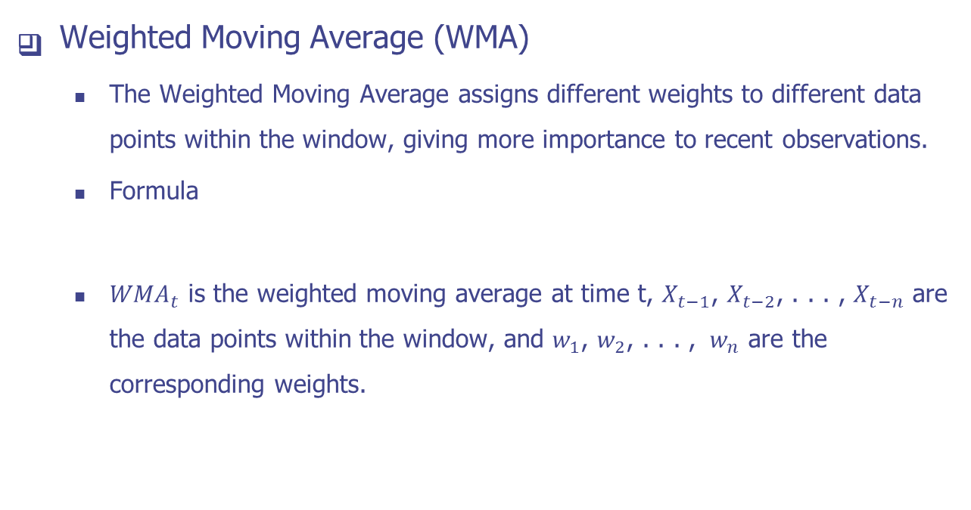
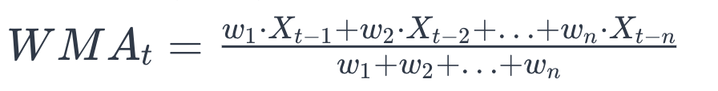
Moving Average Methods
Tips to build the Forecasting

Slide 7
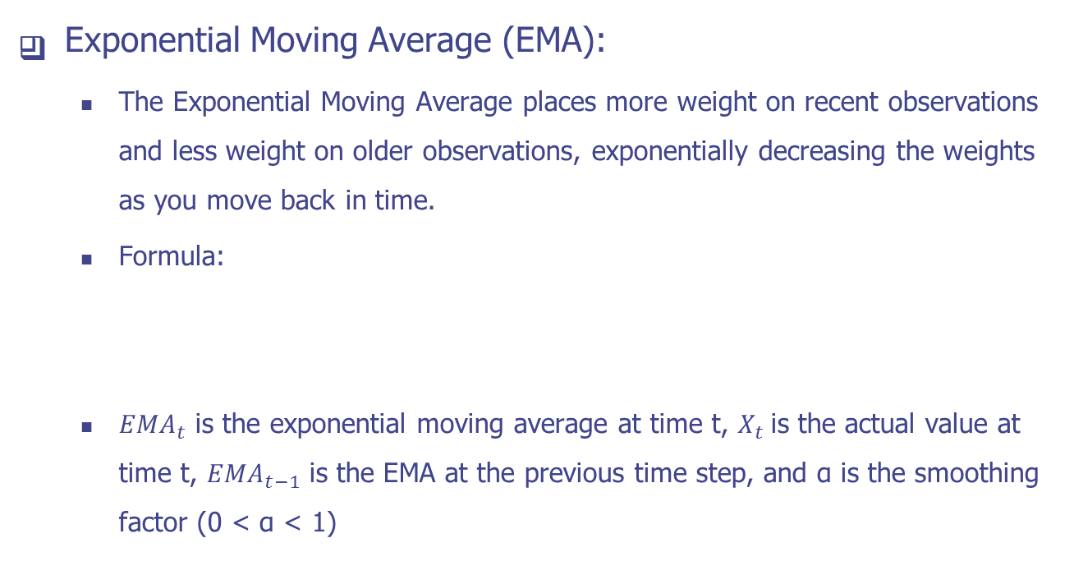
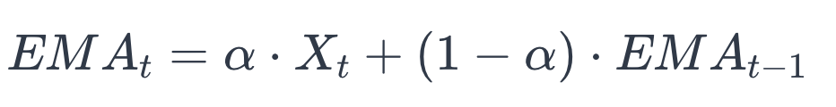
Moving Average Methods
Tips to build the Forecasting

Slide 8
Differencing methods
Differencing is a common technique used in time series forecasting to make a series stationary.
Stationarity is an important concept in time series analysis, and differencing helps stabilize the mean and variance of a series, making it more amenable to modeling.
The differencing method involves computing the difference between consecutive observations, aiming to remove trends and seasonality from the data.
Tips to build the Forecasting

Slide 9
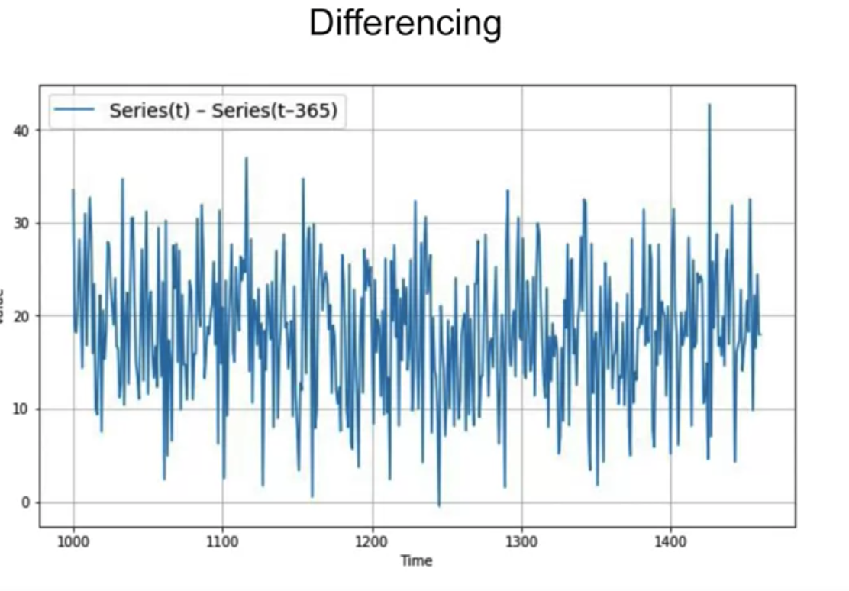
Differencing methods
Tips to build the Forecasting

Slide 10
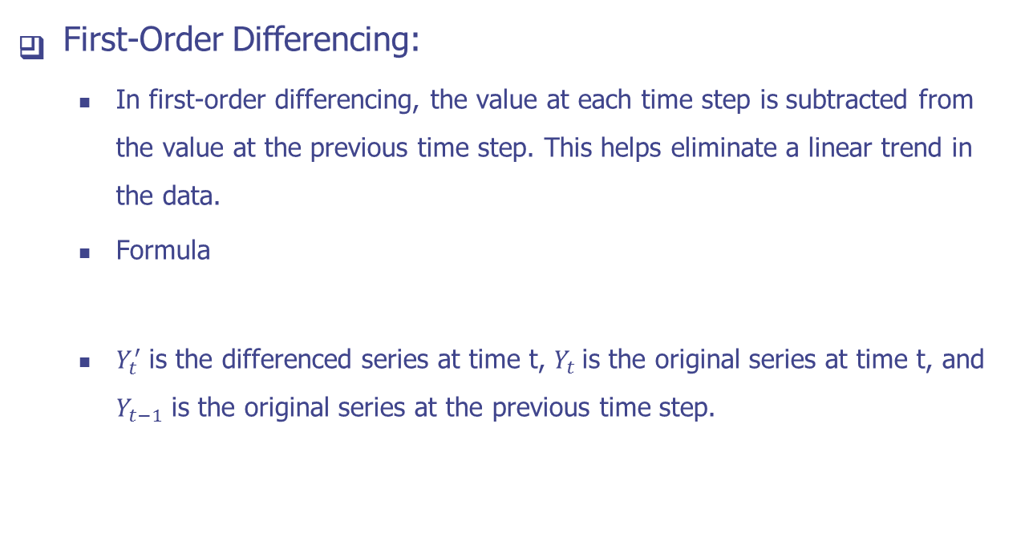
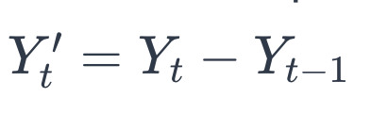
Differencing methods
Tips to build the Forecasting

Slide 11
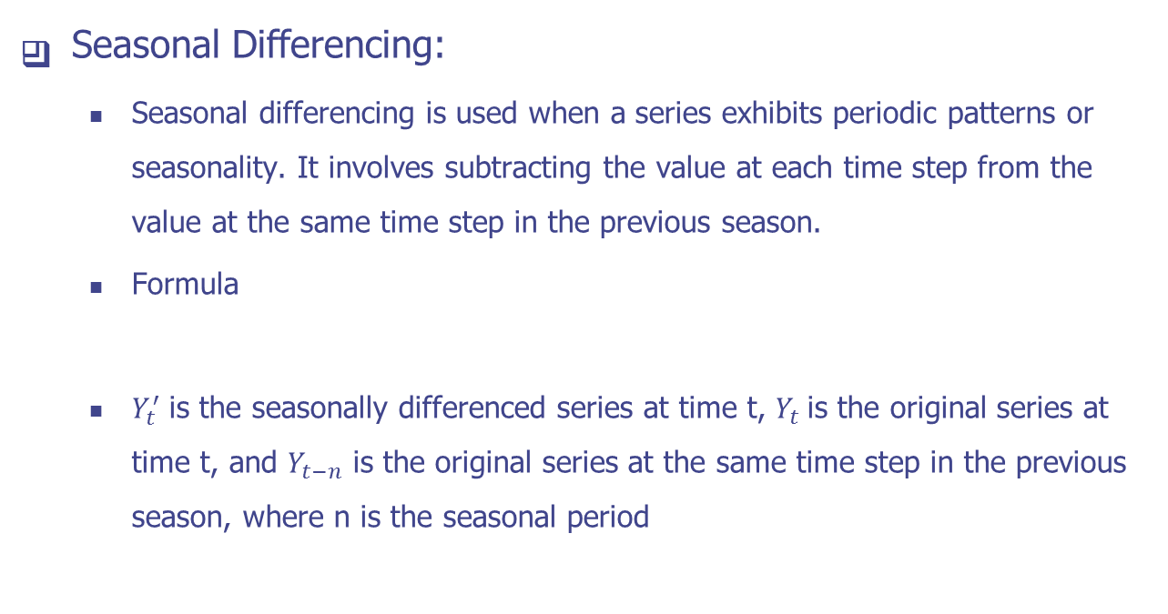
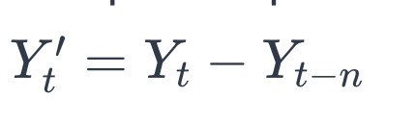
Differencing methods
Tips to build the Forecasting

Slide 12
Differencing methods
Differencing has several benefits in time series forecasting:
  Stationarity: Differencing can help make a time series stationary by removing trends and seasonality. Stationary series are often easier to model and can lead to more accurate forecasts.
  Stabilizing Variance: Differencing can stabilize the variance of a time series, making it more constant over time.
  Removing Trends: By subtracting consecutive values, differencing can remove linear trends and make the series more amenable to modeling with models that assume stationarity.
Tips to build the Forecasting

Slide 13
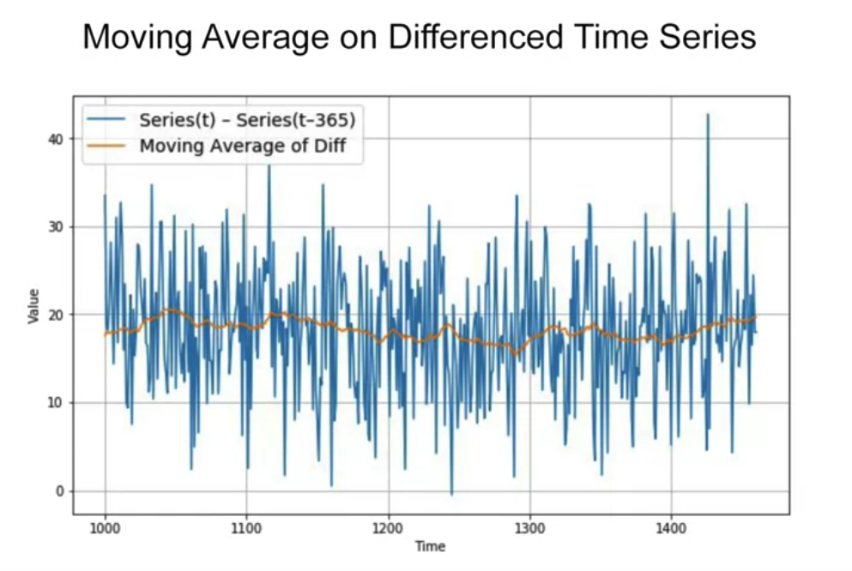
Moving Average on Differenced Time Series
Tips to build the Forecasting

Slide 14
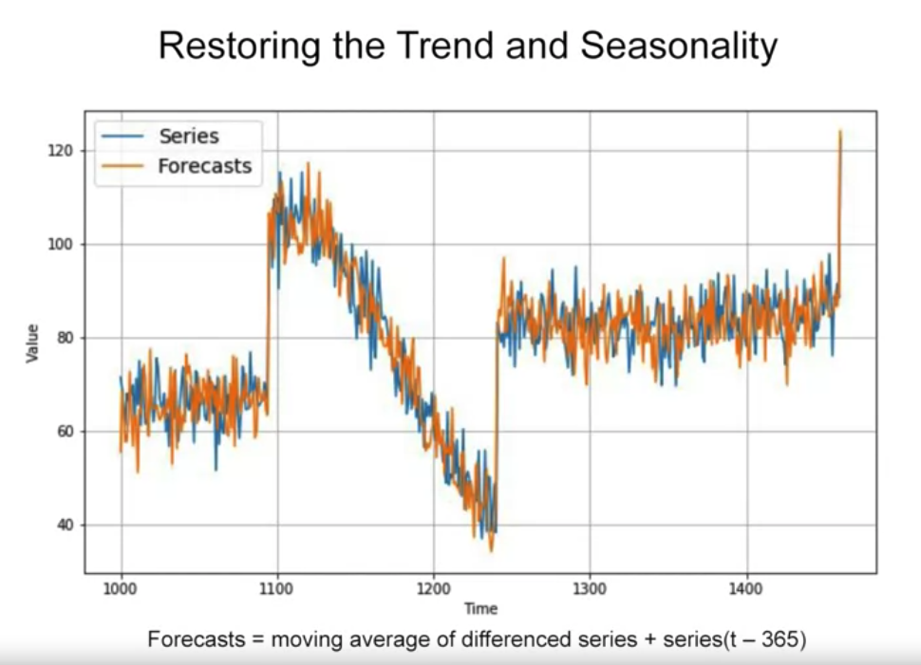
Restoring the Trend and Seasonality
Tips to build the Forecasting

Slide 15
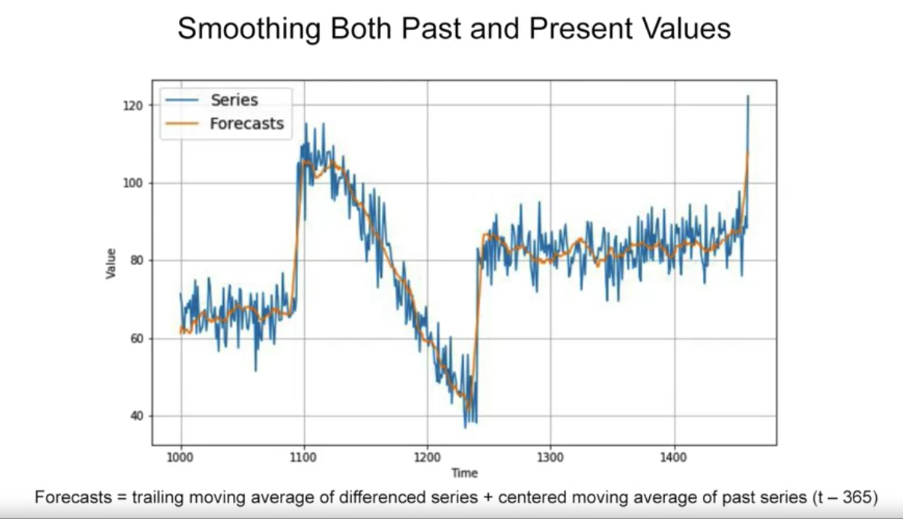
Smoothing Both Past and Present Values
Tips to build the Forecasting

Slide 16
Trailing versus centered windows
Trailing window when computing the moving average of present values But we used a centered window to compute the moving average of past values.
Moving averages using centered windows can be more accurate than using trailing windows.
But we can't use centered windows to smooth present values since we don't know future values. However, to smooth past values we can afford to use centered windows.
Tips to build the Forecasting

Slide 17
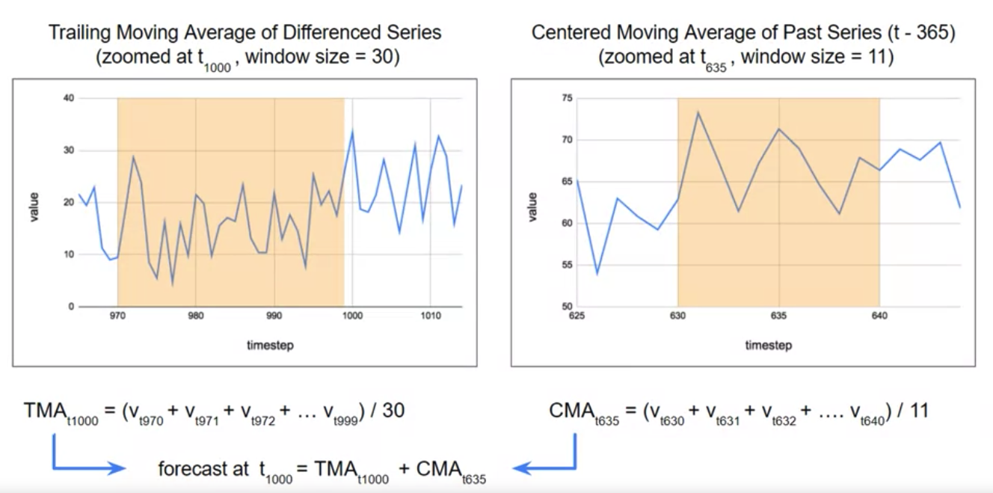
Trailing versus centered windows
Tips to build the Forecasting

Slide 18
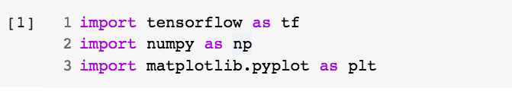
Statistical Forecasting
Imports libs
Tips to build the Forecasting

Slide 19
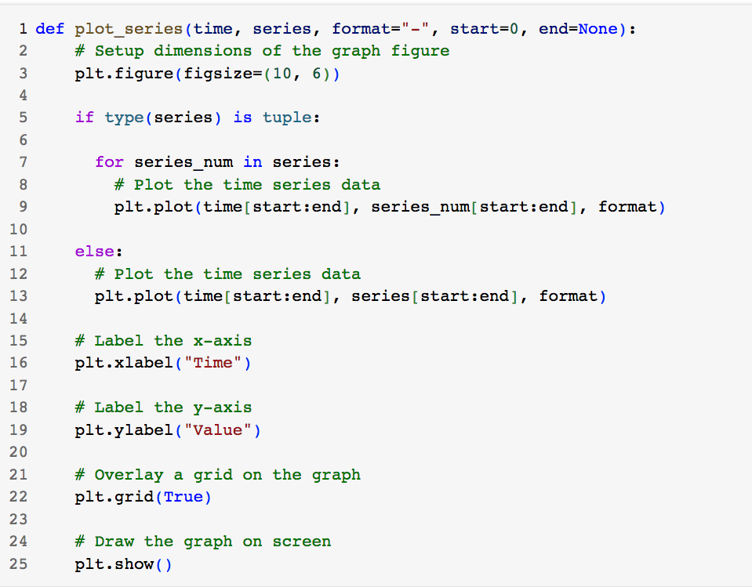
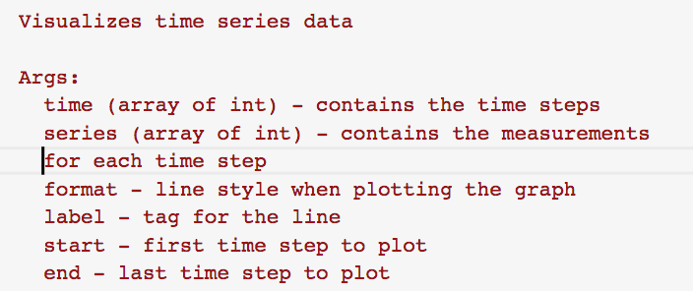
Statistical Forecasting
Create Utilities
Tips to build the Forecasting

Slide 20
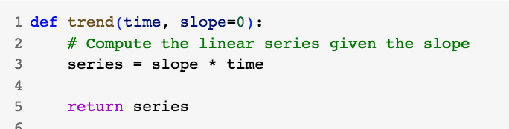
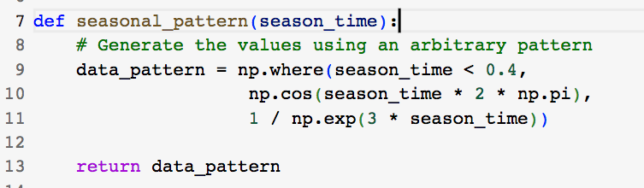
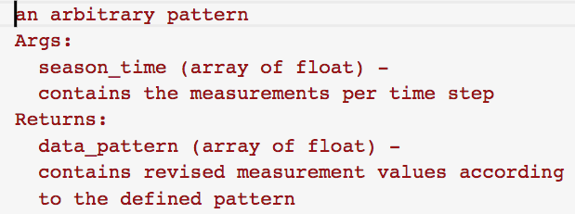
Statistical Forecasting
Create Utilities
Tips to build the Forecasting

Slide 21
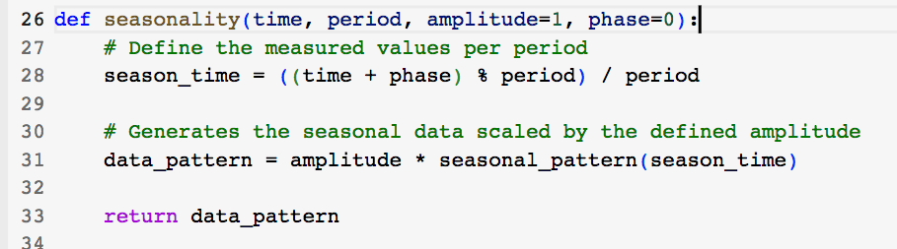
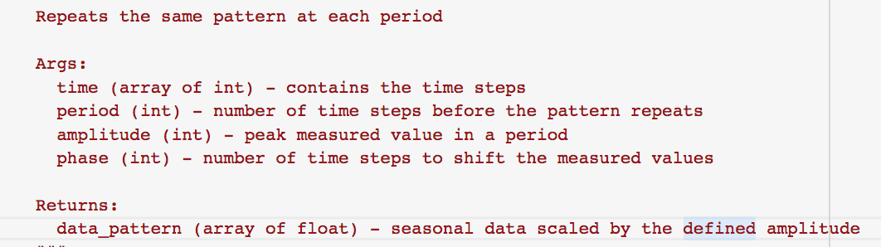
Statistical Forecasting
Create Utilities
Tips to build the Forecasting

Slide 22
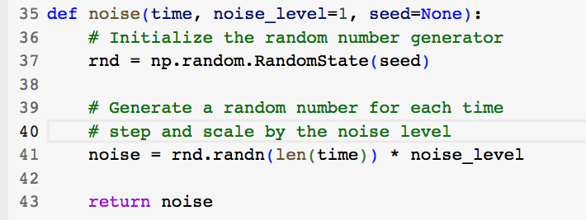
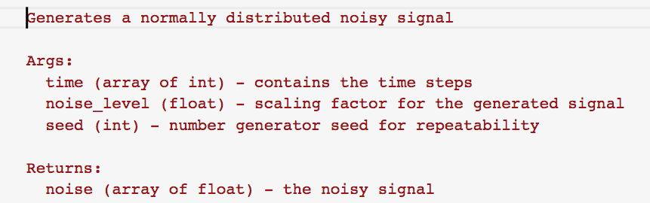
Statistical Forecasting
Create Utilities
Tips to build the Forecasting

Slide 23
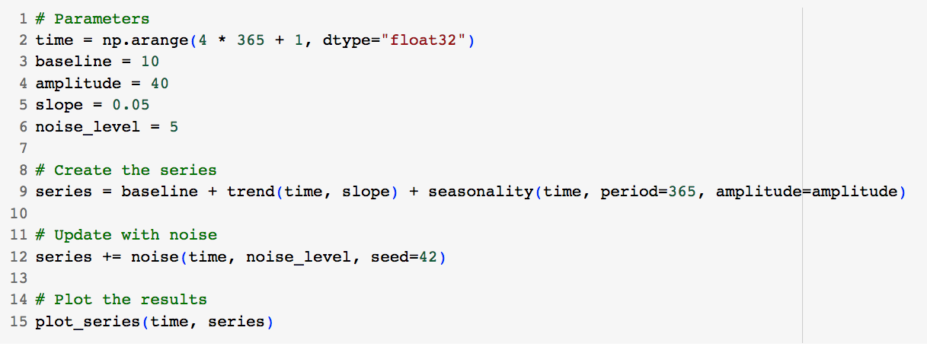
Statistical Forecasting
Generate the synthetic data
Tips to build the Forecasting

Slide 24
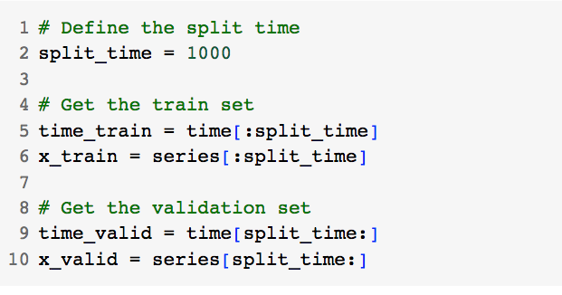
Statistical Forecasting
Split the Dataset
Tips to build the Forecasting

Slide 25
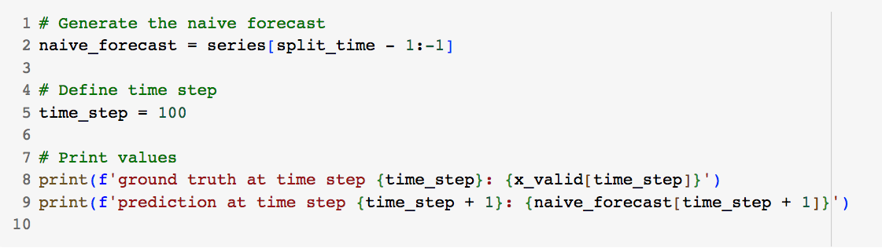
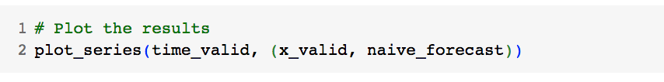

Statistical Forecasting
Naive Forecast
Tips to build the Forecasting

Slide 26
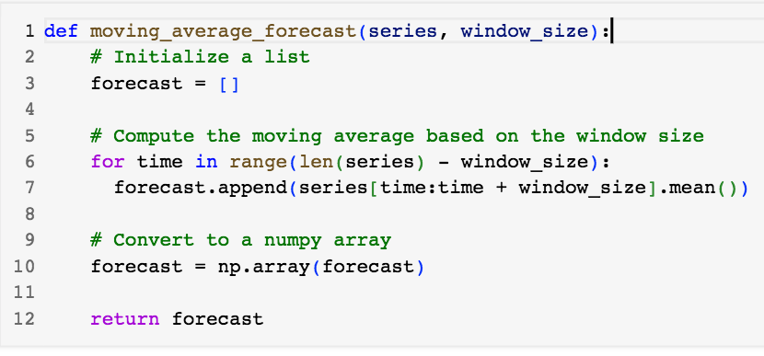
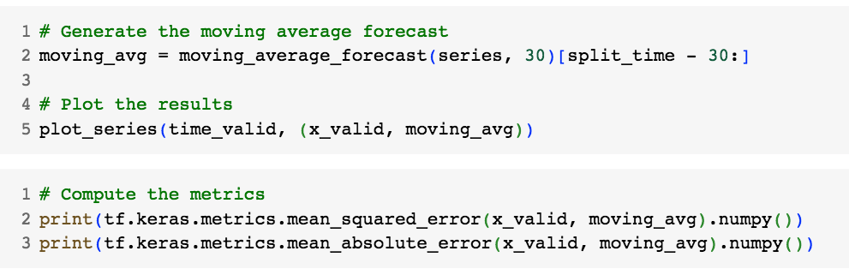
Statistical Forecasting
Moving Average
Tips to build the Forecasting

Slide 27
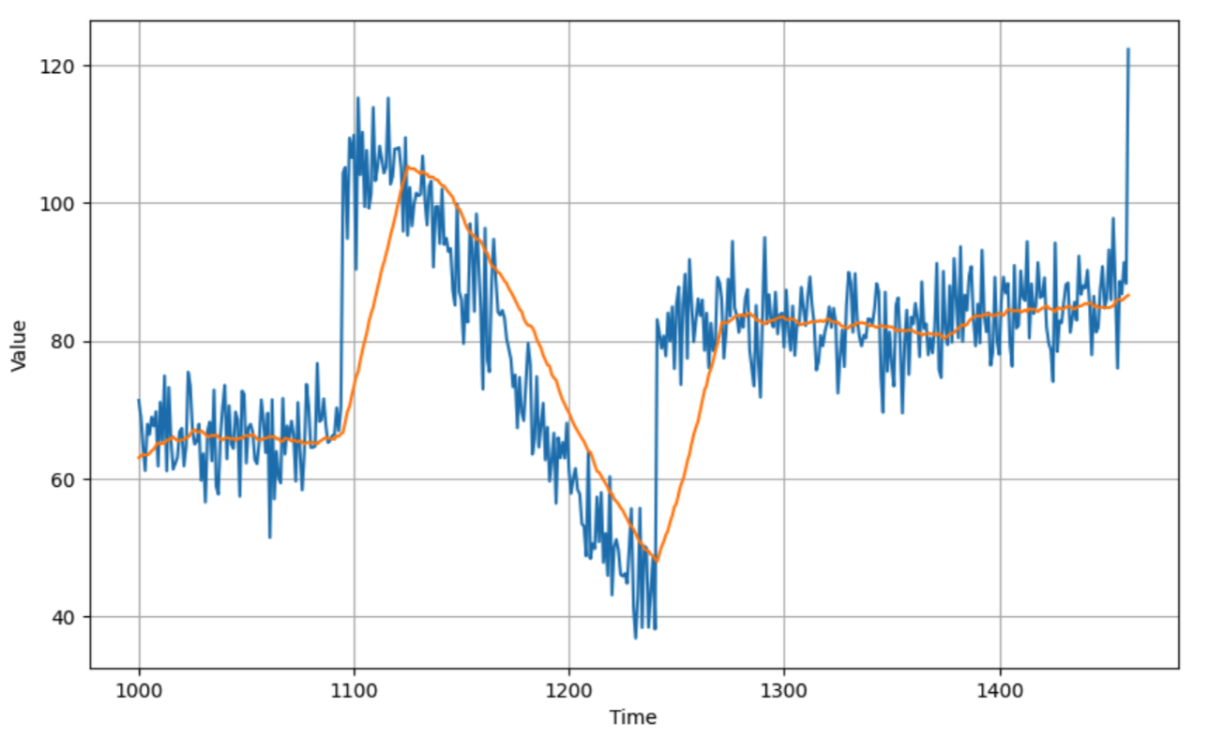
Statistical Forecasting
Moving Average
Tips to build the Forecasting

Slide 28
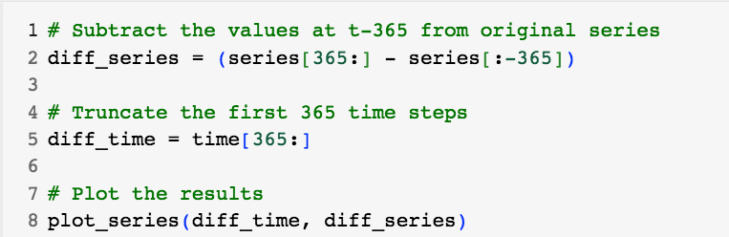
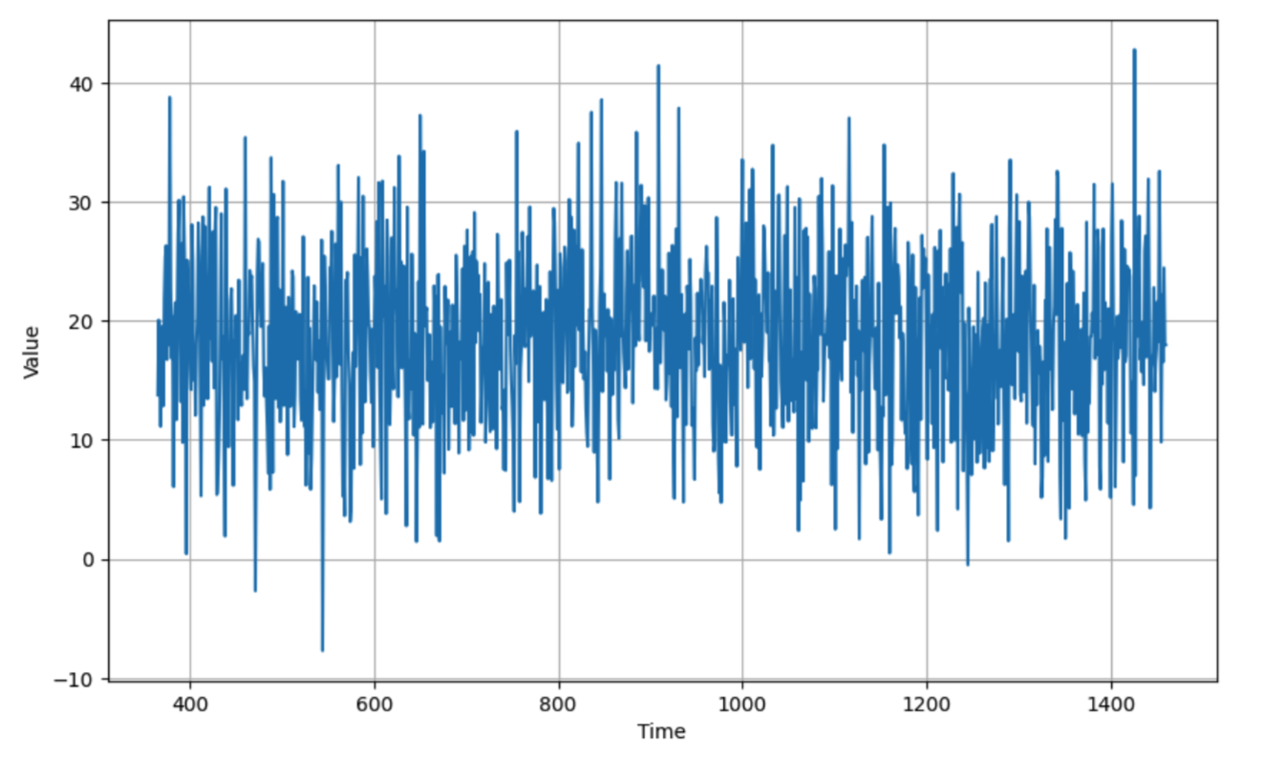
Statistical Forecasting
Differencing
Tips to build the Forecasting

Slide 29
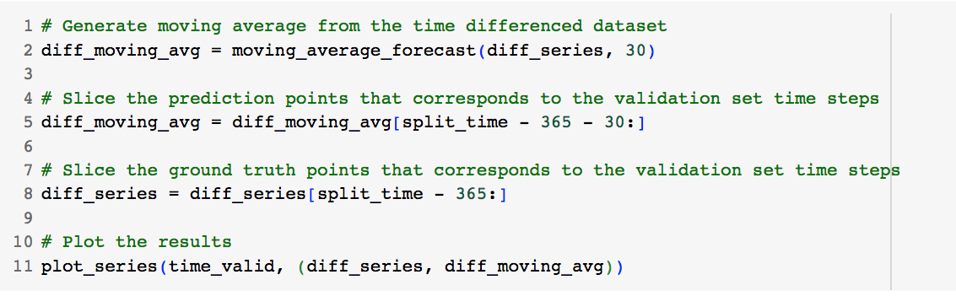
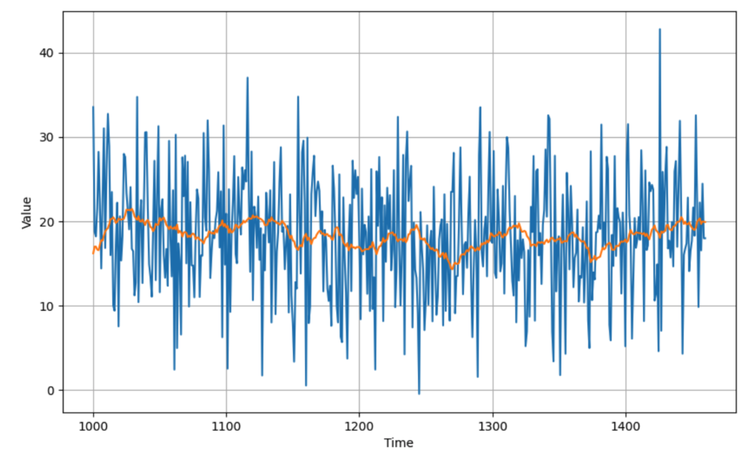
Statistical Forecasting
Differencing
Tips to build the Forecasting

Slide 30
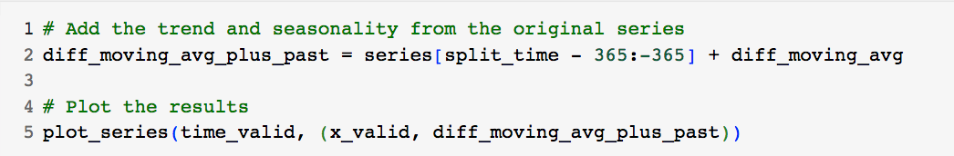
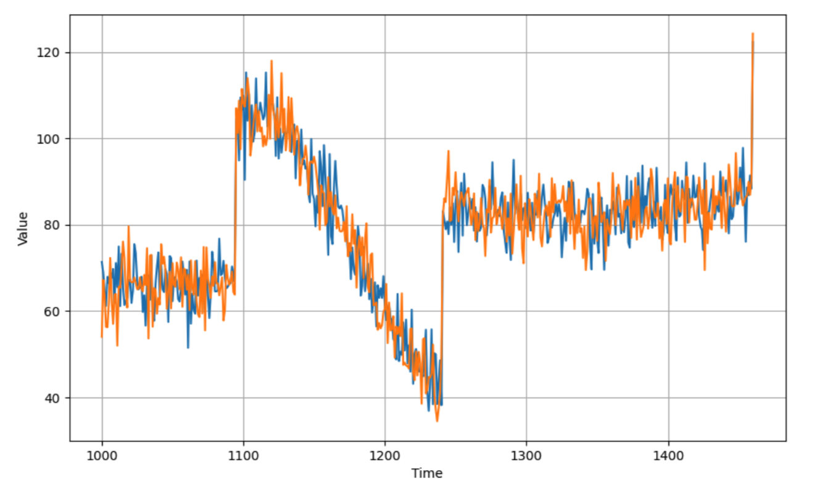
Statistical Forecasting
Differencing
Tips to build the Forecasting

Slide 31
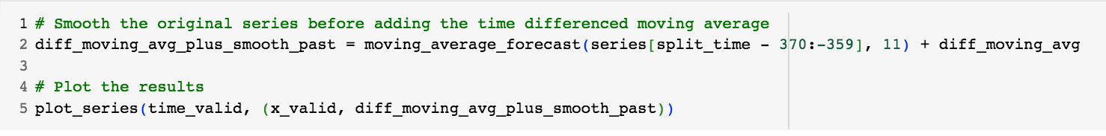
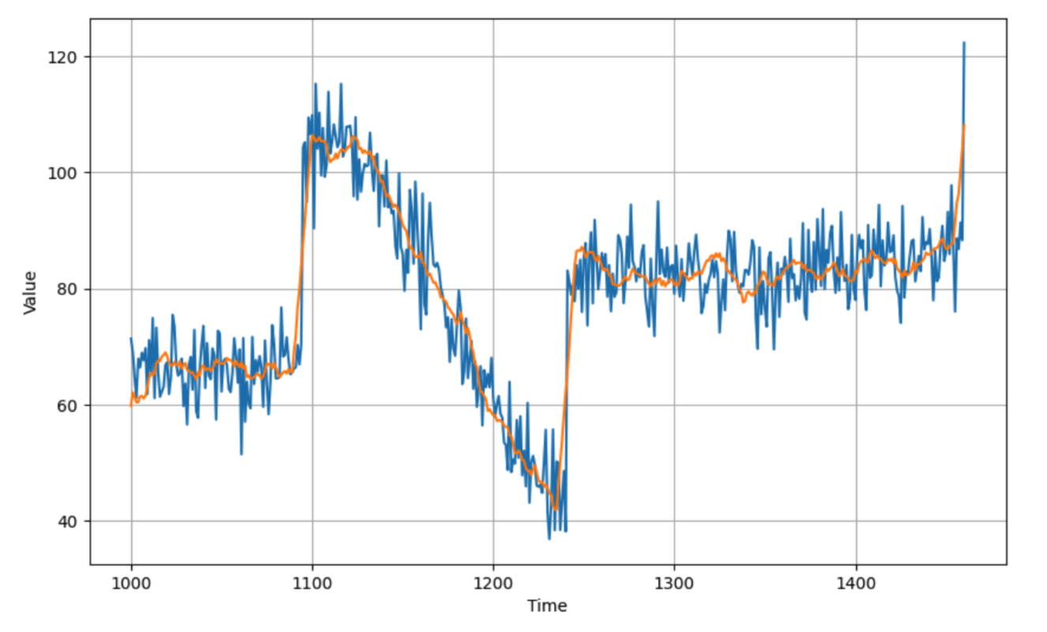
Statistical Forecasting
Smoothing
Tips to build the Forecasting

Slide 32
Statistical Forecasting
Group discuss and give opinions about statistical forecasting methods
Tips to build the Forecasting

Slide 33
Summary
Understand methods for Forecasting
Implement Statistical Forecasting methods
Tips to build the Forecasting

Slide 34
Q & A
Tips to build the Forecasting

